Slide 1
Lecture 7 Software Security
modified from slides of Lawrie Brown
Notes:
In this chapter we turn our attention specifically to buffer overflow attacks. This
type of attack is one of the most common attacks seen and results from careless
programming in applications. A look at the list of vulnerability advisories from
organizations such as CERT or SANS continue to include a significant number of
buffer overflow or heap overflow exploits, including a number of serious, remotely
exploitable vulnerabilities. Similarly, several of the items in the CWE/SANS Top
25 Most Dangerous Software Errors list, Risky Resource Management category,
are buffer overflow variants. These can result in exploits to both operating systems
and common applications.

Slide 2
Buffer Overflow

Slide 3
Buffer Overflow
a very common attack mechanism
first wide use by the Morris Worm in 1988
prevention techniques known
still of major concern
legacy of buggy code in widely deployed operating systems and applications
continued careless programming practices by programmers
Notes:
Yet this type of attack has been known since it was first
widely used by the Morris Internet Worm in 1988, and techniques for preventing
its occurrence are well known and documented. Unfortunately, due to both a legacy of buggy code in widely deployed operating
systems and applications and continuing careless programming practices by programmers,
it is still a major source of concern to security practitioners. This chapter
focuses on how a buffer overflow occurs and what methods can be used to prevent
or detect its occurrence.
We begin with an introduction to the basics of buffer overflow. Then we
present details of the classic stack buffer overflow. This includes a discussion of
how functions store their local variables on the stack and the consequence of
attempting to store more data in them than there is space available. We continue
with an overview of the purpose and design of shellcode, which is the custom code
injected by an attacker and to which control is transferred as a result of the buffer
overflow.
Next we consider ways of defending against buffer overflow attacks. We start
with the obvious approach of preventing them by not writing code that is vulnerable
to buffer overflows in the first place. However, given the large, existing body
of buggy code, we also need to consider hardware and software mechanisms that
can detect and thwart buffer overflow attacks. These include mechanisms to protect
executable address space, techniques to detect stack modifications, and approaches
that randomize the address space layout to hinder successful execution of these
attacks.
Finally, we briefly survey some of the other overflow techniques, including
return to system call and heap overflows, and mention defenses against these.

Slide 4

Buffer Overflow/Buffer Overrun
A buffer overflow, also known as a buffer overrun, is defined in the NIST:
“A condition at an interface under which more input can be placed into a buffer or data holding area than the capacity allocated, overwriting other information. Attackers exploit such a condition to crash a system or to insert specially crafted code that allows them to gain control of the system.”
Notes:
A buffer overflow , also known as a buffer overrun , is defined in the NIST Glossary
of Key Information Security Terms as follows:
Buffer Overrun A condition at an interface under which more input can be
placed into a buffer or data holding area than the capacity allocated, overwriting
other information. Attackers exploit such a condition to crash a system or to
insert specially crafted code that allows them to gain control of the system.

Slide 5
Buffer Overflow Basics
programming error when a process attempts to store data beyond the limits of a fixed-sized buffer
overwrites adjacent memory locations
locations could hold other program variables, parameters, or program control flow data
buffer could be located on the stack, in the heap, or in the data section of the process
consequences:
corruption of program data
unexpected transfer of control
memory access violations
execution of code chosen by attacker
Notes:
A buffer overflow can occur as a result of a programming error when a process
attempts to store data beyond the limits of a fixed-sized buffer and consequently
overwrites adjacent memory locations. These locations could hold other program
variables or parameters or program control flow data such as return addresses and
pointers to previous stack frames. The buffer could be located on the stack, in the
heap, or in the data section of the process. The consequences of this error include
corruption of data used by the program, unexpected transfer of control in the program,
possibly memory access violations, and very likely eventual program termination.
When done deliberately as part of an attack on a system, the transfer of control
could be to code of the attacker’s choosing, resulting in the ability to execute arbitrary
code with the privileges of the attacked process.

Slide 6
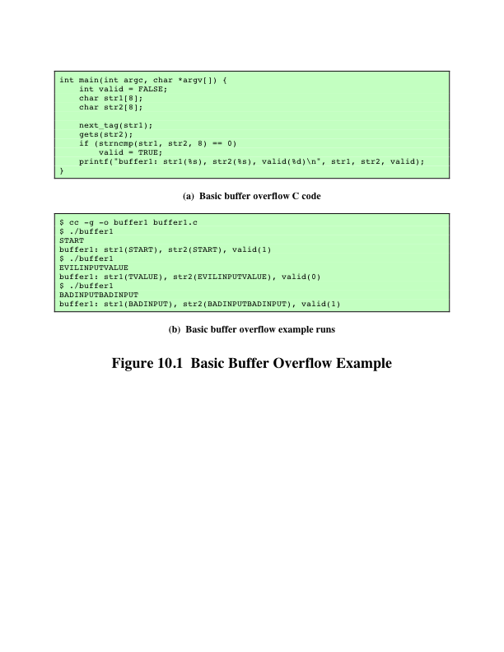
Basic Buffer Overflow Example
Notes:
To illustrate the basic operation of a buffer overflow, consider the C main function
given in Figure 10.1a . This contains three variables (valid , str1, and str2),
whose values will typically be saved in adjacent memory locations. The order and
location of these will depend on the type of variable (local or global), the language
and compiler used, and the target machine architecture.

Slide 7
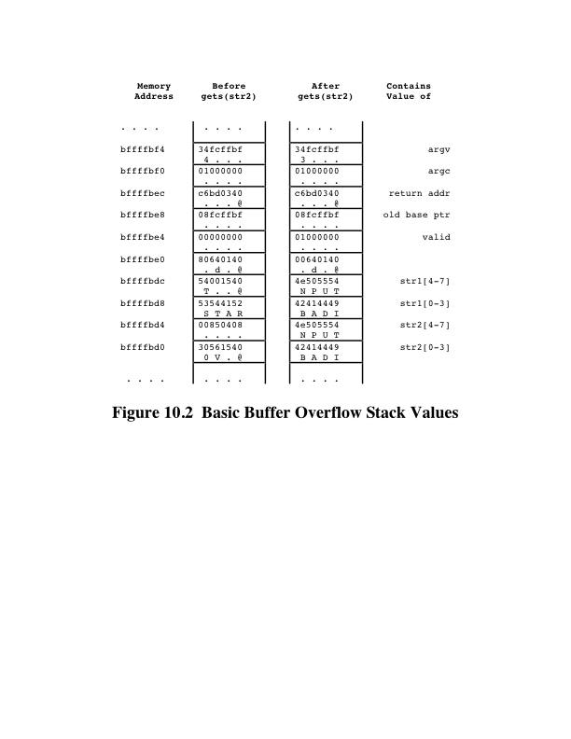
Basic Buffer Overflow Stack Values
Notes:
However, for the purpose
of this example we will assume that they are saved in consecutive memory locations,
from highest to lowest, as shown in Figure 10.2 .This will typically be the case for
local variables in a C function on common processor architectures such as the Intel
Pentium family. The purpose of the code fragment is to call the function next_
tag(str1) to copy into str1 some expected tag value. Let’s assume this will be
the string START. It then reads the next line from the standard input for the program
using the C library gets() function and then compares the string read with the
expected tag. If the next line did indeed contain just the string START, this comparison
would succeed, and the variable VALID would be set to TRUE. This case
is shown in the first of the three example program runs in Figure 10.1b . Any other
input tag would leave it with the value FALSE. Such a code fragment might be used
to parse some structured network protocol interaction or formatted text file.
The problem with this code exists because the traditional C library gets() function
does not include any checking on the amount of data copied. It will read the next
line of text from the program’s standard input up until the first newline character
occurs and copy it into the supplied buffer followed by the NULL terminator used with
C strings. If more than seven characters are present on the input line, when read in they
will (along with the terminating NULL character) require more room than is available
in the str2 buffer. Consequently, the extra characters will proceed to overwrite the values
of the adjacent variable, str1 in this case. For example, if the input line contained
EVILINPUTVALUE, the result will be that str1 will be overwritten with the characters
TVALUE, and str2 will use not only the eight characters allocated to it but seven more
from str1 as well. This can be seen in the second example run in Figure 10.1b . The overflow
has resulted in corruption of a variable not directly used to save the input. Because
these strings are not equal, valid also retains the value FALSE. Further, if 16 or more
characters were input, additional memory locations would be overwritten.

Slide 8
Buffer Overflow Attacks
to exploit a buffer overflow an attacker needs:
to identify a buffer overflow vulnerability in some program that can be triggered using externally sourced data under the attacker’s control
to understand how that buffer is stored in memory and determine potential for corruption
identifying vulnerable programs can be done by:
inspection of program source
tracing the execution of programs as they process oversized input
using tools such as fuzzing to automatically identify potentially vulnerable programs
Notes:
To exploit any type of buffer overflow, such as those we have illustrated here,
the attacker needs
1. To identify a buffer overflow vulnerability in some program that can be
triggered using externally sourced data under the attackers control, and
2. To understand how that buffer will be stored in the processes memory, and
hence the potential for corrupting adjacent memory locations and potentially
altering the flow of execution of the program.
Identifying vulnerable programs may be done by inspection of program
source, tracing the execution of programs as they process oversized input, or using
tools such as fuzzing , which we discuss in Chapter 11 .2, to automatically identify
potentially vulnerable programs. What the attacker does with the resulting corruption
of memory varies considerably, depending on what values are being overwritten.
We will explore some of the alternatives in the following sections.

Slide 9
Program Security

Slide 10
Secure programs
Security implies some degree of trust that the program enforces expected
confidentiality,
integrity, and
availability.
How can we look at software component and assess its security?

Slide 11
Secure programs
Why is it so hard to write secure programs?
Axiom (Murphy):
Programs have bugs
Corollary:
Security-relevant programs have security bugs

Slide 12
Software Security Issues
many vulnerabilities result from poor programming practices
consequence from insufficient checking and validation of data and error codes
awareness of these issues is a critical initial step in writing more secure program code
software error categories:
insecure interaction between components
risky resource management
porous defenses
Notes:
Many computer security vulnerabilities result from poor programming practices.
The CWE/SANS Top 25 Most Dangerous Software Errors list, summarized in
Table 11.1 , details the consensus view on the poor programming practices that
are the cause of the majority of cyber attacks. These errors are grouped into three
categories: insecure interaction between components, risky resource management,
and porous defenses. Similarly, the Open Web Application Security Project Top
Ten list of critical Web application security flaws includes five related to insecure
software code. These include unvalidated input, cross-site scripting, buffer overflow,
injection flaws, and improper error handling. These flaws occur as a consequence
of insufficient checking and validation of data and error codes in programs.
Awareness of these issues is a critical initial step in writing more secure program
code. Both these sources emphasize the need for software developers to address
these known areas of concern, and provide guidance on how this is done. We discuss
most of these flaws in this chapter.

Slide 13
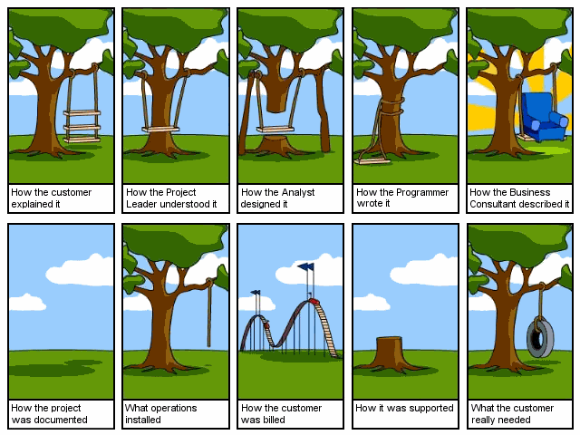
Secure programs
Evaluation of what is “Secure” is subject to the perspective of the evaluator
Managers
Developers
Technicians
Clients

Slide 14
Software Quality and Reliability
concerned with accidental failure of program
as a result of some theoretically random, unanticipated input, system interaction, or use of incorrect code
improve using structured design and testing to identify and eliminate as many bugs as possible from a program
concern is how often they are triggered
failures are expected to follow some form of probability distribution
Notes:
Software security is closely related to software quality and reliability, but with
subtle differences. Software quality and reliability is concerned with the accidental
failure of a program as a result of some theoretically random, unanticipated input,
system interaction, or use of incorrect code. These failures are expected to follow
some form of probability distribution. The usual approach to improve software
quality is to use some form of structured design and testing to identify and eliminate
as many bugs as is reasonably possible from a program. The testing usually
involves variations of likely inputs and common errors, with the intent of minimizing
the number of bugs that would be seen in general use. The concern is not the total
number of bugs in a program, but how often they are triggered, resulting in program
failure.
Software security differs in that the attacker chooses the probability distribution,
targeting specific bugs that result in a failure that can be exploited by the attacker.
These bugs may often be triggered by inputs that differ dramatically from what is
usually expected and hence are unlikely to be identified by common testing approaches.

Slide 15
Software Security
attacker chooses probability distribution, specifically targeting bugs that result in a failure that can be exploited by the attacker
triggered by inputs that differ dramatically from what is usually expected
unlikely to be identified by common testing approaches
Notes:
Software security is closely related to software quality and reliability, but with
subtle differences. Software quality and reliability is concerned with the accidental
failure of a program as a result of some theoretically random, unanticipated input,
system interaction, or use of incorrect code. These failures are expected to follow
some form of probability distribution. The usual approach to improve software
quality is to use some form of structured design and testing to identify and eliminate
as many bugs as is reasonably possible from a program. The testing usually
involves variations of likely inputs and common errors, with the intent of minimizing
the number of bugs that would be seen in general use. The concern is not the total
number of bugs in a program, but how often they are triggered, resulting in program
failure.
Software security differs in that the attacker chooses the probability distribution,
targeting specific bugs that result in a failure that can be exploited by the attacker.
These bugs may often be triggered by inputs that differ dramatically from what is
usually expected and hence are unlikely to be identified by common testing approaches.

Slide 16
Defensive Programming
also called secure programming
a form of defensive design to ensure continued function of software despite unforeseen usage
requires attention to all aspects of program execution, environment, and type of data it processes
assume nothing, check all potential errors
programmer never assumes a particular function call or library will work as advertised so handles it in the code
Notes:
Writing secure, safe code requires attention to all aspects of how a program executes,
the environment it executes in, and the type of data it processes. Nothing can be
assumed, and all potential errors must be checked. These issues are highlighted in the
Wikipedia article on defensive programming, which notes the following:
Defensive programming : is a form of defensive design intended to ensure
the continuing function of a piece of software in spite of unforeseeable usage
of said software. The idea can be viewed as reducing or eliminating the
prospect of Murphy’s Law having effect. Defensive programming techniques
come into their own when a piece of software could be misused mischievously
or inadvertently to catastrophic effect.
. . .
Defensive programming is sometimes referred to as secure programming .
This is because many software bugs can be potentially used by a cracker for a
code injection, denial-of-service attack or other attack. A difference between
defensive programming and normal practices is that nothing is assumed. All
error states are accounted for and handled. In short, the programmer never
assumes a particular function call or library will work as advertised, and so
handles it in the code.

Slide 17
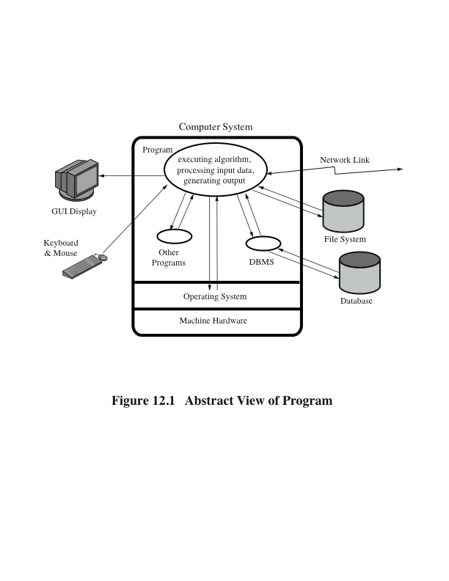
Abstract Program Model
Notes:
This definition emphasizes the need to make explicit any assumptions about how
a program will run, and the types of input it will process. To help clarify the issues,
consider the abstract model of a program shown in Figure 11.1. This illustrates
the concepts taught in most introductory programming courses. A program reads
input data from a variety of possible sources, processes that data according to some
algorithm, and then generates output, possibly to multiple different destinations. It
executes in the environment provided by some operating system, using the machine
instructions of some specific processor type. While processing the data, the program
will use system calls, and possibly other programs available on the system. These
may result in data being saved or modified on the system or cause some other side
effect as a result of the program execution. All of these aspects can interact with
each other, often in complex ways.

Slide 18

Defensive Programming
programmers often make assumptions about the type of inputs a program will receive and the environment it executes in
assumptions need to be validated by the program and all potential failures handled gracefully and safely
requires a changed mindset to traditional programming practices
programmers have to understand how failures can occur and the steps needed to reduce the chance of them occurring in their programs
conflicts with business pressures to keep development times as short as possible to maximize market advantage
Notes:
When writing a program, programmers typically focus on what is needed to
solve whatever problem the program addresses. Hence their attention is on the steps
needed for success and the normal flow of execution of the program rather than
considering every potential point of failure. They often make assumptions about the
type of inputs a program will receive and the environment it executes in. Defensive
programming means these assumptions need to be validated by the program and all
potential failures handled gracefully and safely. Correctly anticipating, checking,
and handling all possible errors will certainly increase the amount of code needed
in, and the time taken to write, a program. This conflicts with business pressures to
keep development times as short as possible to maximize market advantage. Unless
software security is a design goal, addressed from the start of program development,
a secure program is unlikely to result.
Further, when changes are required to a program, the programmer often
focuses on the changes required and what needs to be achieved. Again, defensive
programming means that the programmer must carefully check any assumptions
made, check and handle all possible errors, and carefully check any interactions with
existing code. Failure to identify and manage such interactions can result in incorrect
program behavior and the introduction of vulnerabilities into a previously secure
program.
Defensive programming thus requires a changed mindset to traditional
programming practices, with their emphasis on programs that solve the desired
problem for most users, most of the time. This changed mindset means the
programmer needs an awareness of the consequences of failure and the techniques
used by attackers. Paranoia is a virtue, because the enormous growth in vulnerability
reports really does show that attackers are out to get you! This mindset has to
recognize that normal testing techniques will not identify many of the vulnerabilities
that may exist but that are triggered by highly unusual and unexpected inputs.
It means that lessons must be learned from previous failures, ensuring that new
programs will not suffer the same weaknesses. It means that programs should be
engineered, as far as possible, to be as resilient as possible in the face of any error
or unexpected condition. Defensive programmers have to understand how failures
can occur and the steps needed to reduce the chance of them occurring in their
programs.

Slide 19
Security by Design
security and reliability are common design goals in most engineering disciplines
software development not as mature
much higher failure levels tolerated
despite having a number of software development and quality standards
main focus is general development lifecycle
increasingly identify security as a key goal
Notes:
The necessity for security and reliability to be design goals from the inception
of a project has long been recognized by most engineering disciplines. Society
in general is intolerant of bridges collapsing, buildings falling down, or airplanes
crashing. The design of such items is expected to provide a high likelihood that these
catastrophic events will not occur. Software development has not yet reached this
level of maturity, and society tolerates far higher levels of failure in software than
it does in other engineering disciplines. This is despite the best efforts of software
engineers and the development of a number of software development and quality
standards [SEI06], [ISO12207]. While the focus of these standards is on the general
software development life cycle, they increasingly identify security as a key design
goal. In recent years, major companies, including Microsoft and IBM, have increasingly
recognized the importance of software security. This is a positive development,
but it needs to be repeated across the entire software industry before significant
progress can be made to reduce the torrent of software vulnerability reports.
The topic of software development techniques and standards, and the
integration of security with them, is well beyond the scope of this text. [MCGR06]
and [VIEG01] provide much greater detail on these topics. However, we will
explore some specific software security issues that should be incorporated into a
wider development methodology. We examine the software security concerns of the
various interactions with an executing program, as illustrated in Figure 11.1 . We start
with the critical issue of safe input handling, followed by security concerns related
to algorithm implementation, interaction with other components, and program
output. When looking at these potential areas of concern, it is worth acknowledging
that many security vulnerabilities result from a small set of common mistakes. We
discuss a number of these.
The examples in this chapter focus primarily on problems seen in Web application
security. The rapid development of such applications, often by developers with
insufficient awareness of security concerns, and their accessibility via the Internet to
a potentially large pool of attackers mean these applications are particularly vulnerable.
However, we emphasize that the principles discussed apply to all programs.
Safe programming practices should always be followed, even for seemingly innocuous
programs, because it is very difficult to predict the future uses of programs. It
is always possible that a simple utility, designed for local use, may later be incorporated
into a larger application, perhaps Web enabled, with significantly different
security concerns.

Slide 20
Software Protection

Slide 21
Input Fuzzing
developed by Professor Barton Miller at the University of Wisconsin Madison in 1989
software testing technique that uses randomly generated data as inputs to a program
range of inputs is very large
intent is to determine if the program or function correctly handles abnormal inputs
simple, free of assumptions, cheap
assists with reliability as well as security
can also use templates to generate classes of known problem inputs
disadvantage is that bugs triggered by other forms of input would be missed
combination of approaches is needed for reasonably comprehensive coverage of the inputs
Notes:
Clearly, there is a problem anticipating and testing for all potential types of nonstandard
inputs that might be exploited by an attacker to subvert a program.
A powerful, alternative approach called fuzzing was developed by Professor Barton
Miller at the University of Wisconsin Madison in 1989. This is a software testing
technique that uses randomly generated data as inputs to a program. The range of
inputs that may be explored is very large. They include direct textual or graphic
input to a program, random network requests directed at a Web or other distributed
service, or random parameters values passed to standard library or system functions.
The intent is to determine whether the program or function correctly handles
all such abnormal inputs or whether it crashes or otherwise fails to respond appropriately.
In the latter cases the program or function clearly has a bug that needs to
be corrected. The major advantage of fuzzing is its simplicity and its freedom from
assumptions about the expected input to any program, service, or function. The cost
of generating large numbers of tests is very low. Further, such testing assists in identifying
reliability as well as security deficiencies in programs.
While the input can be completely randomly generated, it may also be randomly
generated according to some template. Such templates are designed to examine
likely scenarios for bugs. This might include excessively long inputs or textual
inputs that contain no spaces or other word boundaries, for example. When used
with network protocols, a template might specifically target critical aspects of the
protocol. The intent of using such templates is to increase the likelihood of locating
bugs. The disadvantage is that the templates incorporate assumptions about the
input. Hence bugs triggered by other forms of input would be missed. This suggests
that a combination of these approaches is needed for a reasonably comprehensive
coverage of the inputs.
Professor Miller’s team has applied fuzzing tests to a number of common
operating systems and applications. These include common command-line and GUI
applications running on Linux, Windows NT, and, most recently, Mac OS X. The
results of the latest tests are summarized in [MILL07], which identifies a number of
programs with bugs in these various systems. Other organizations have used these
tests on a variety of systems and software.
While fuzzing is a conceptually very simple testing method, it does have its
limitations. In general, fuzzing only identifies simple types of faults with handling of
input. If a bug exists that is only triggered by a small number of very specific input
values, fuzzing is unlikely to locate it. However, the types of bugs it does locate are
very often serious and potentially exploitable. Hence it ought to be deployed as a
component of any reasonably comprehensive testing strategy.
A number of tools to perform fuzzing tests are now available and are used
by organizations and individuals to evaluate security of programs and applications.
They include the ability to fuzz command-line arguments, environment variables,
Web applications, file formats, network protocols, and various forms of interprocess
communications. A number of suitable black box test tools, include fuzzing tests,
are described in [MIRA05]. Such tools are being used by organizations to improve
the security of their software. Fuzzing is also used by attackers to identify potentially
useful bugs in commonly deployed software. Hence it is becoming increasingly
important for developer and maintainers to also use this technique to locate and
correct such bugs before they are found and exploited by attackers.

Slide 22
Writing Safe Program Code
second component is processing of data by some algorithm to solve required problem
high-level languages are typically compiled and linked into machine code which is then directly executed by the target processor
security issues:
correct algorithm implementation
correct machine instructions for algorithm
valid manipulation of data
Notes:
The second component of our model of computer programs is the processing of
the input data according to some algorithm. For procedural languages like C and
its descendents, this algorithm specifies the series of steps taken to manipulate the
input to solve the required problem. High-level languages are typically compiled
and linked into machine code, which is then directly executed by the target processor.
In Section 10.1 we discuss the typical process structure used by executing
programs. Alternatively, a high-level language such as Java may be compiled into
an intermediate language that is then interpreted by a suitable program on the
target system. The same may be done for programs written using an interpreted
scripting language. In all cases the execution of a program involves the execution of
machine language instructions by a processor to implement the desired algorithm.
These instructions will manipulate data stored in various regions of memory and in
the processor’s registers.
From a software security perspective, the key issues are whether the implemented
algorithm correctly solves the specified problem, whether the machine
instructions executed correctly represent the high-level algorithm specification, and
whether the manipulation of data values in variables, as stored in machine registers
or memory, is valid and meaningful.

Slide 23
Correct Algorithm Implementation
issue of good program development technique
algorithm may not correctly handle all problem variants
consequence of deficiency is a bug in the resulting program that could be exploited
initial sequence numbers used by many TCP/IP implementations are too predictable
combination of the sequence number as an identifier and authenticator of packets and the failure to make them sufficiently unpredictable enables the attack to occur
Notes:
The first issue is primarily one of good program development technique. The
algorithm may not correctly implement all cases or variants of the problem. This
might allow some seemingly legitimate program input to trigger program behavior
that was not intended, providing an attacker with additional capabilities. While this
may be an issue of inappropriate interpretation or handling of program input, as
we discuss in Section 11.2 , it may also be inappropriate handling of what should be
valid input. The consequence of such a deficiency in the design or implementation
of the algorithm is a bug in the resulting program that could be exploited.
A good example of this was the bug in some early releases of the Netscape Web
browser. Their implementation of the random number generator used to generate
session keys for secure Web connections was inadequate [GOWA01]. The assumption
was that these numbers should be unguessable, short of trying all alternatives.
However, due to a poor choice of the information used to seed this algorithm, the
resulting numbers were relatively easy to predict. As a consequence, it was possible
for an attacker to guess the key used and then decrypt the data exchanged over a
secure Web session. This flaw was fixed by reimplementing the random number
generator to ensure that it was seeded with sufficient unpredictable information
that it was not possible for an attacker to guess its output.
Another well-known example is the TCP session spoof or hijack attack. This
extends the concept we discussed in Section 7.1 of sending source spoofed packets
to a TCP server. In this attack, the goal is not to leave the server with half-open
connections, but rather to fool it into accepting packets using a spoofed source
address that belongs to a trusted host but actually originates on the attacker’s system.
If the attack succeeded, the server could be convinced to run commands or
provide access to data allowed for a trusted peer, but not generally. To understand
the requirements for this attack, consider the TCP three-way connection handshake
illustrated in Figure 7.2 . Recall that because a spoofed source address is used,
the response from the server will not be seen by the attacker, who will not therefore
know the initial sequence number provided by the server. However, if the attacker
can correctly guess this number, a suitable ACK packet can be constructed and sent
to the server, which then assumes that the connection is established. Any subsequent
data packet is treated by the server as coming from the trusted source, with
the rights assigned to it. The hijack variant of this attack waits until some authorized
external user connects and logs in to the server. Then the attacker attempts
to guess the sequence numbers used and to inject packets with spoofed details to
mimic the next packets the server expects to see from the authorized user. If the
attacker guesses correctly, then the server responds to any requests using the access
rights and permissions of the authorized user. There is an additional complexity to
these attacks. Any responses from the server are sent to the system whose address
is being spoofed. Because they acknowledge packets this system has not sent,
the system will assume there is a network error and send a reset (RST) packet to
terminate the connection. The attacker must ensure that the attack packets reach
the server and are processed before this can occur. This may be achieved by launching
a denial-of-service attack on the spoofed system while simultaneously attacking
the target server.
The implementation flaw that permits these attacks is that the initial sequence
numbers used by many TCP/IP implementations are far too predictable. In addition,
the sequence number is used to identify all packets belonging to a particular session.
The TCP standard specifies that a new, different sequence number should be used
for each connection so that packets from previous connections can be distinguished.
Potentially this could be a random number (subject to certain constraints). However,
many implementations used a highly predictable algorithm to generate the next initial
sequence number. The combination of the implied use of the sequence number as an
identifier and authenticator of packets belonging to a specific TCP session and the
failure to make them sufficiently unpredictable enables the attack to occur. A number
of recent operating system releases now support truly randomized initial sequence
numbers. Such systems are immune to these types of attacks.
Another variant of this issue is when the programmers deliberately include
additional code in a program to help test and debug it. While this valid during
program development, all too often this code remains in production releases of a
program. At the very least, this code could inappropriately release information to a
user of the program. At worst, it may permit a user to bypass security checks or other
program limitations and perform actions they would not otherwise be allowed to
perform. This type of vulnerability was seen in the sendmail mail delivery program
in the late 1980s and famously exploited by the Morris Internet Worm. The implementers
of sendmail had left in support for a DEBUG command that allowed the
user to remotely query and control the running program [SPAF89]. The Worm used
this feature to infect systems running versions of sendmail with this vulnerability.
The problem was aggravated because the sendmail program ran using superuser
privileges and hence had unlimited access to change the system. We discuss the issue
of minimizing privileges further in Section 11.4 .
A further example concerns the implementation of an interpreter for a highor
intermediate-level languages. The assumption is that the interpreter correctly
implements the specified program code. Failure to adequately reflect the language
semantics could result in bugs that an attacker might exploit. This was clearly seen
when some early implementations of the Java Virtual Machine (JVM) inadequately
implemented the security checks specified for remotely sourced code, such as in
applets [DEFW96]. These implementations permitted an attacker to introduce code
remotely, such as on a Web page, but trick the JVM interpreter into treating them
as locally sourced and hence trusted code with much greater access to the local
system and data.
These examples illustrate the care that is needed when designing and implementing
a program. It is important to specify assumptions carefully, such as that
generated random number should indeed be unpredictable, in order to ensure that
these assumptions are satisfied by the resulting program code. It is also very important
to identify debugging and testing extensions to the program and to ensure that
they are removed or disabled before the program is distributed and used.

Slide 24
Correct Algorithm Implementation
another variant is when the programmers deliberately include additional code in a program to help test and debug it
often code remains in production release of a program and could inappropriately release information
may permit a user to bypass security checks and perform actions they would not otherwise be allowed to perform
this vulnerability was exploited by the Morris Internet Worm
Notes:
The first issue is primarily one of good program development technique. The
algorithm may not correctly implement all cases or variants of the problem. This
might allow some seemingly legitimate program input to trigger program behavior
that was not intended, providing an attacker with additional capabilities. While this
may be an issue of inappropriate interpretation or handling of program input, as
we discuss in Section 11.2 , it may also be inappropriate handling of what should be
valid input. The consequence of such a deficiency in the design or implementation
of the algorithm is a bug in the resulting program that could be exploited.
A good example of this was the bug in some early releases of the Netscape Web
browser. Their implementation of the random number generator used to generate
session keys for secure Web connections was inadequate [GOWA01]. The assumption
was that these numbers should be unguessable, short of trying all alternatives.
However, due to a poor choice of the information used to seed this algorithm, the
resulting numbers were relatively easy to predict. As a consequence, it was possible
for an attacker to guess the key used and then decrypt the data exchanged over a
secure Web session. This flaw was fixed by reimplementing the random number
generator to ensure that it was seeded with sufficient unpredictable information
that it was not possible for an attacker to guess its output.
Another well-known example is the TCP session spoof or hijack attack. This
extends the concept we discussed in Section 7.1 of sending source spoofed packets
to a TCP server. In this attack, the goal is not to leave the server with half-open
connections, but rather to fool it into accepting packets using a spoofed source
address that belongs to a trusted host but actually originates on the attacker’s system.
If the attack succeeded, the server could be convinced to run commands or
provide access to data allowed for a trusted peer, but not generally. To understand
the requirements for this attack, consider the TCP three-way connection handshake
illustrated in Figure 7.2 . Recall that because a spoofed source address is used,
the response from the server will not be seen by the attacker, who will not therefore
know the initial sequence number provided by the server. However, if the attacker
can correctly guess this number, a suitable ACK packet can be constructed and sent
to the server, which then assumes that the connection is established. Any subsequent
data packet is treated by the server as coming from the trusted source, with
the rights assigned to it. The hijack variant of this attack waits until some authorized
external user connects and logs in to the server. Then the attacker attempts
to guess the sequence numbers used and to inject packets with spoofed details to
mimic the next packets the server expects to see from the authorized user. If the
attacker guesses correctly, then the server responds to any requests using the access
rights and permissions of the authorized user. There is an additional complexity to
these attacks. Any responses from the server are sent to the system whose address
is being spoofed. Because they acknowledge packets this system has not sent,
the system will assume there is a network error and send a reset (RST) packet to
terminate the connection. The attacker must ensure that the attack packets reach
the server and are processed before this can occur. This may be achieved by launching
a denial-of-service attack on the spoofed system while simultaneously attacking
the target server.
The implementation flaw that permits these attacks is that the initial sequence
numbers used by many TCP/IP implementations are far too predictable. In addition,
the sequence number is used to identify all packets belonging to a particular session.
The TCP standard specifies that a new, different sequence number should be used
for each connection so that packets from previous connections can be distinguished.
Potentially this could be a random number (subject to certain constraints). However,
many implementations used a highly predictable algorithm to generate the next initial
sequence number. The combination of the implied use of the sequence number as an
identifier and authenticator of packets belonging to a specific TCP session and the
failure to make them sufficiently unpredictable enables the attack to occur. A number
of recent operating system releases now support truly randomized initial sequence
numbers. Such systems are immune to these types of attacks.
Another variant of this issue is when the programmers deliberately include
additional code in a program to help test and debug it. While this valid during
program development, all too often this code remains in production releases of a
program. At the very least, this code could inappropriately release information to a
user of the program. At worst, it may permit a user to bypass security checks or other
program limitations and perform actions they would not otherwise be allowed to
perform. This type of vulnerability was seen in the sendmail mail delivery program
in the late 1980s and famously exploited by the Morris Internet Worm. The implementers
of sendmail had left in support for a DEBUG command that allowed the
user to remotely query and control the running program [SPAF89]. The Worm used
this feature to infect systems running versions of sendmail with this vulnerability.
The problem was aggravated because the sendmail program ran using superuser
privileges and hence had unlimited access to change the system. We discuss the issue
of minimizing privileges further in Section 11.4 .
A further example concerns the implementation of an interpreter for a highor
intermediate-level languages. The assumption is that the interpreter correctly
implements the specified program code. Failure to adequately reflect the language
semantics could result in bugs that an attacker might exploit. This was clearly seen
when some early implementations of the Java Virtual Machine (JVM) inadequately
implemented the security checks specified for remotely sourced code, such as in
applets [DEFW96]. These implementations permitted an attacker to introduce code
remotely, such as on a Web page, but trick the JVM interpreter into treating them
as locally sourced and hence trusted code with much greater access to the local
system and data.
These examples illustrate the care that is needed when designing and implementing
a program. It is important to specify assumptions carefully, such as that
generated random number should indeed be unpredictable, in order to ensure that
these assumptions are satisfied by the resulting program code. It is also very important
to identify debugging and testing extensions to the program and to ensure that
they are removed or disabled before the program is distributed and used.

Slide 25
Ensuring Machine Language Corresponds to Algorithm
issue is ignored by most programmers
assumption is that the compiler or interpreter generates or executes code that validly implements the language statements
requires comparing machine code with original source
slow and difficult
development of computer systems with very high assurance level is the one area where this level of checking is required
specifically Common Criteria assurance level of EAL 7
Notes:
The second issue concerns the correspondence between the algorithm specified in
some programming language and the machine instructions that are run to implement
it. This issue is one that is largely ignored by most programmers. The assumption
is that the compiler or interpreter does indeed generate or execute code that
validly implements the language statements. When this is considered, the issue is
typically one of efficiency, usually addressed by specifying the required level of
optimization flags to the compiler.
With compiled languages, as Ken Thompson famously noted in [THOM84], a
malicious compiler programmer could include instructions in the compiler to emit
additional code when some specific input statements were processed. These statements
could even include part of the compiler, so that these changes could be reinserted
when the compiler source code was compiled, even after all trace of them
had been removed from the compiler source. If this were done, the only evidence
of these changes would be found in the machine code. Locating this would require
careful comparison of the generated machine code with the original source. For
large programs, with many source files, this would be an exceedingly slow and difficult
task, one that, in general, is very unlikely to be done.
The development of trusted computer systems with very high assurance level
is the one area where this level of checking is required. Specifically, certification
of computer systems using a Common Criteria assurance level of EAL 7 requires
validation of the correspondence among design, source code, and object code. We
discuss this further in Chapter 13 .

Slide 26
Correct Data Interpretation
data stored as bits/bytes in computer
grouped as words or longwords
accessed and manipulated in memory or copied into processor registers before being used
interpretation depends on machine instruction executed
different languages provide different capabilities for restricting and validating interpretation of data in variables
strongly typed languages are more limited, safer
other languages allow more liberal interpretation of data and permit program code to explicitly change their interpretation
Notes:
The next issue concerns the correct interpretation of data values. At the most basic
level, all data on a computer are stored as groups of binary bits. These are generally
saved in bytes of memory, which may be grouped together as a larger unit, such as a
word or longword value. They may be accessed and manipulated in memory, or they
may be copied into processor registers before being used. Whether a particular group
of bits is interpreted as representing a character, an integer, a floating-point number,
a memory address (pointer), or some more complex interpretation depends on the
program operations used to manipulate it and ultimately on the specific machine
instructions executed. Different languages provide varying capabilities for restricting
and validating assumptions on the interpretation of data in variables. If the language
includes strong typing, then the operations performed on any specific type of data
will be limited to appropriate manipulations of the values. This greatly reduces the
likelihood of inappropriate manipulation and use of variables introducing a flaw in
the program. Other languages, though, allow a much more liberal interpretation of
data and permit program code to explicitly change their interpretation. The widely
used language C has this characteristic, as we discuss in Section 10.1 . In particular,
it allows easy conversion between interpreting variables as integers and interpreting
them as memory addresses (pointers). This is a consequence of the close relationship
between C language constructs and the capabilities of machine language instructions,
and it provides significant benefits for system level programming. Unfortunately, it
also allows a number of errors caused by the inappropriate manipulation and use of
pointers. The prevalence of buffer overflow issues, as we discuss in Chapter 10 , is one
consequence. A related issue is the occurrence of errors due to the incorrect manipulation
of pointers in complex data structures, such as linked lists or trees, resulting in
corruption of the structure or changing of incorrect data values. Any such programming
bugs could provide a means for an attacker to subvert the correct operation of
a program or simply to cause it to crash.
The best defense against such errors is to use a strongly typed programming
language. However, even when the main program is written in such a language,
it will still access and use operating system services and standard library routines,
which are currently most likely written in languages like C, and could potentially
contain such flaws. The only counter to this is to monitor any bug reports for the
system being used and to try and not use any routines with known, serious bugs. If a
loosely typed language like C is used, then due care is needed whenever values are
cast between data types to ensure that their use remains valid.

Slide 27
Correct Use of Memory
issue of dynamic memory allocation
used to manipulate unknown amounts of data
allocated when needed, released when done
memory leak
steady reduction in memory available on the heap to the point where it is completely exhausted
many older languages have no explicit support for dynamic memory allocation
use standard library routines to allocate and release memory
modern languages handle automatically
Notes:
Related to the issue of interpretation of data values is the allocation and management
of dynamic memory storage, generally using the process heap. Many
programs, which manipulate unknown quantities of data, use dynamically allocated
memory to store data when required. This memory must be allocated when needed
and released when done. If a program fails to correctly manage this process, the
consequence may be a steady reduction in memory available on the heap to the
point where it is completely exhausted. This is known as a memory leak , and often
the program will crash once the available memory on the heap is exhausted. This
provides an obvious mechanism for an attacker to implement a denial-of-service
attack on such a program.
Many older languages, including C, provide no explicit support for dynamically
allocated memory. Instead support is provided by explicitly calling standard
library routines to allocate and release memory. Unfortunately, in large, complex
programs, determining exactly when dynamically allocated memory is no longer
required can be a difficult task. As a consequence, memory leaks in such programs
can easily occur and can be difficult to identify and correct. There are library
variants that implement much higher levels of checking and debugging such allocations
that can be used to assist this process.
Other languages like Java and C manage memory allocation and release
automatically. While such languages do incur an execution overhead to support this
automatic management, the resulting programs are generally far more reliable. The
use of such languages is strongly encouraged to avoid memory management problems.

Slide 28
Race Conditions
without synchronization of accesses it is possible that
values may be corrupted or
changes lost due to overlapping access, use, and replacement of shared values
arise when writing concurrent code whose solution requires the correct selection and use of appropriate synchronization primitives
deadlock
processes or threads wait on a resource held by the other
one or more programs has to be terminated
Notes:
Another topic of concern is management of access to common, shared memory by
several processes or threads within a process. Without suitable synchronization of
accesses, it is possible that values may be corrupted, or changes lost, due to overlapping
access, use, and replacement of shared values. The resulting race condition
occurs when multiple processes and threads compete to gain uncontrolled access
to some resource. This problem is a well-known and documented issue that arises
when writing concurrent code, whose solution requires the correct selection and
use of appropriate synchronization primitives. Even so, it is neither easy nor obvious
what the most appropriate and efficient choice is. If an incorrect sequence
of synchronization primitives is chosen, it is possible for the various processes or
threads to deadlock , each waiting on a resource held by the other. There is no easy
way of recovering from this flaw without terminating one or more of the programs.
An attacker could trigger such a deadlock in a vulnerable program to implement a
denial-of-service upon it. In large complex applications, ensuring that deadlocks are
not possible can be very difficult. Care is needed to carefully design and partition
the problem to limit areas where access to shared memory is needed and to determine
the best primitives to use.

Slide 29
Operating System Interaction
programs execute on systems under the control of an operating system
mediates and shares access to resources
constructs execution environment
includes environment variables and arguments
systems have a concept of multiple users
resources are owned by a user and have permissions granting access with various rights to different categories of users
programs need access to various resources,
however excessive levels of access are dangerous
concerns when multiple programs access shared resources such as a common file
Notes:
The third component of our model of computer programs is that it executes on a
computer system under the control of an operating system. This aspect of a computer
program is often not emphasized in introductory programming courses; however,
from the perspective of writing secure software, it is critical. Excepting dedicated
embedded applications, in general, programs do not run in isolation on most
computer systems. Rather, they run under the control of an operating system that
mediates access to the resources of that system and shares their use between all the
currently executing programs.
The operating system constructs an execution environment for a process when
a program is run, as illustrated in Figure 10.4 . In addition to the code and data for
the program, the process includes information provided by the operating system.
These include environment variables, which may be used to tailor the operation of
the program, and any command-line arguments specified for the program. All such
data should be considered external inputs to the program whose values need validation
before use, as we discuss in Section 11.2 .

Slide 30
Summary
writing safe program code
correct algorithm implementation
ensuring machine language corresponds to algorithm
correct interpretation of data values
correct use of memory
preventing race conditions
interacting with the operating system and other programs
environment variables
least privileges
safe temporary file use
preventing race conditions
software security issues
defensive/secure programming
handling program input
key concern for input:
size /interpretation
injection attack
command /SQL /code
cross-site scripting attacks
XSS reflection
validating input syntax
input fuzzing
handling program output
Notes:
Chapter 11 summary.

